Slide 1
DS6057 Business Analytics
MSDS PROGRAM
UNIT 9
How to Successfully Apply Analytics to Your Business to Deliver Economic Impact & Achieve Strategic Competitive Advantage
Disclaimer. The information contained herein is confidential and is the intellectual property of Optima Analytics.
Do not copy, reproduce, or distribute without expressed written consent of Douglas A. Gray, President, Optima Analytics. 2015

Slide 2
UNIT 9 Outline
Minimizing Readmittance: Minimizing Discomfort and Saving $$$
Substance Abuse Rehabilitation Re-admission Predictor
Evidence-based Medicine: Spinal Surgery Predictor
DR. Probe and Predicting Orthopedic Surgery Re-admission.

Slide 3
Unit 9
Minimizing Readmittance:
Minimizing Discomfort and Saving $$$

Slide 4
Healthcare Industry
$3T US Industry (2015) ~ 20% GDP; $7T Globally => $8.7T (2020)
25-30% of every dollar spent goes to Administration
Three primary goals for healthcare entities:
Patient Outcome & Quality of Life
Patient Quality of Care
Economic Efficiency & Financial Performance (Hospitals, Insurance, Pharma, etc.)
Trend towards ”Evidence-based” Medicine, e.g., stomach ulcer case
Based on Data & Data Science, including AI, Machine Learning

Slide 5
Hospital Readmissions
Readmissions are a particularly chronic problem today, top causes being:
Infection (Sepsis), Blood poisoning (Septicemia)
Pneumonia
Congestive heart failure
Complications of surgical or medical care
The cost of all readmissions must now be borne by the hospital provider
In 2011, 3.3M adult all-cause readmissions associated with $41.3B in hospital costs
Medicare patient top 3 readmission conditions resulted in $4.3B in hospital costs
Medicaid patient top 3 readmission conditions resulted in $839M in hospital costs
Privately insured patient top 3 readmission conditions resulted in $785M in hospital costs
https://www.verywellhealth.com/sepsis-and-septicemia-2615130

Slide 7
Cigna
White Paper

Slide 8
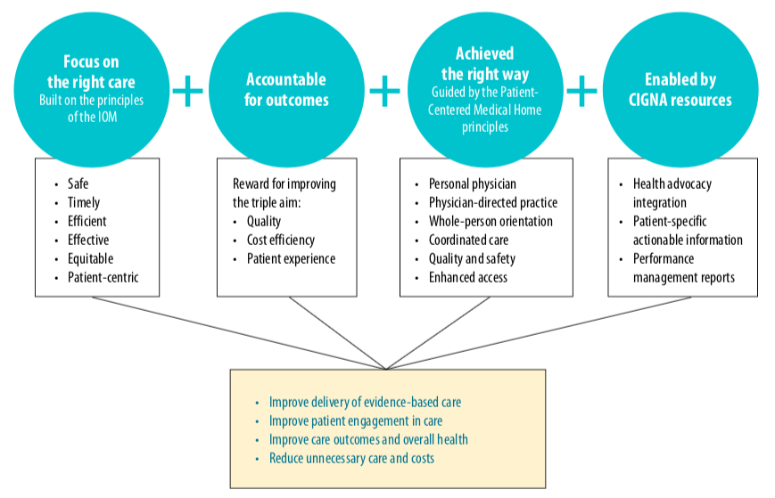
Cigna Collaborative Accountable Care
Patient-Centered Medical Home
Accountable Care Organizations – quality, affordability, experience of care

Slide 9
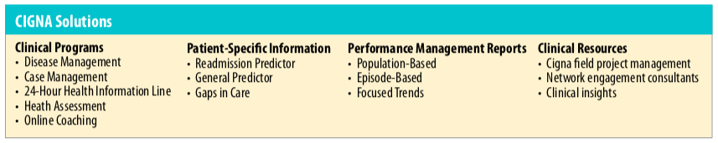
Cigna Solutions

Slide 11
Case Analysis
Substance Abuse Re-habilitation

Slide 12
Readmissions are a huge source of costs for hospitals and insurers
According to the Agency for Healthcare Research and Quality (AHRQ):
Hospitals spent $41.3 billion between January and November 2011 to treat patients readmitted within 30 days of discharge
1.8 million readmissions cost the Medicare program $24 billion
600,000 privately insured patient readmittance totaled $8.1 billion
700,000 Medicaid patient readmissions cost hospitals $7.6 billion,
The 200,000 uninsured patients who were readmitted cost hospitals a relatively paltry $1.5 billion.

Slide 13
Causes of Readmissions
Complications from Surgery or Treatment
Infection
Relapse of a physical malady or other condition
Related (direct or indirect) health episode

Slide 14
Setting
For a project with a $2B US Midwest healthcare insurer who wanted to look more closely at substance abuse patients who were readmitted versus those who were not.

Slide 15
Goal
Identify and intercept those with a high propensity for readmissions and advise, treat, and counsel them accordingly

Slide 16
Classifying and Predicting Patient Post-discharge Behavior
Classification, Segmentation, Propensity to re-admit
Latent Class Modeling
K-means Clustering, CART/CHAID
Logistic Regression (Odds of re-admitting)

Slide 17
Data
Medical History Data including pre-existing and current conditions
Demographic & Psychographic Data from Acxiom
Prior Readmission History

Slide 18
Frame & Solve: Analytics Solution Approach
Healthcare Industry
Healthcare Insurer
“Substance abuse readmissions have increased 33% YOY”
“Limited patient care staff cannot amply support all recently released patients”

Slide 19
Frame & Solve: Analytics Solution Approach
“How can we focus patient care staff on the patients at highest risk of readmission?”
Identify (predict) patients who may be prone to substance abuse rehabilitation readmission & care for them to reduce their likelihood of readmission
Predictive
Stochastic
There are a dozen or more variables that can influence whether or not a patient will readmit after rehabilitation
Predicting readmission with certainty is not possible; predict the “probability” of a patient readmitting after rehabilitation
Probability – Bayesian Inference
Odds or [p/(1-p)] - Logistic Regression

Slide 20

Bayesian Inference Model
The “Swiss Army Knife” of modern statistical predictive modeling
Breast Cancer Screening Indicator (BCSI) Test
BCSI Test Result | True Cancer State | Patient Has Cancer | Patient Has No Cancer | Total # PatientsTested
POS + |  | 88 | 36 | 124
NEG - |  | 18 | 37 | 55
Total |  | 106 | 73 | 179
Modeling Propensity of an Outcome Given Prior Information and Empirical Information
Disease State given a Test Result
Heart attack or stroke
Hospital readmission
Consumer behavior, e.g., product purchase, churn
P(Patient Has Cancer/POS + Test Result) = 88 / 124 = 71%
P(POS + Test Result/Patient Has No Cancer) = 36 /73 = 49%

Slide 22
Case Analysis
Spinal Surgery Predictor

Slide 23
Spinal surgery can often be avoided or postponed indefinitely with…
Weight Loss
Exercise
Physical Therapy or Occupational Therapy
Improved mechanics
Medications

Slide 24
Goal
Goal identify and intercept with a high propensity for Spinal Surgery and advise and counsel them with alternative non-invasive, non-surgical treatments

Slide 25
Methods: Classifying and Predicting Patient Propensity for Spinal Surgery
Classification, Segmentation, Propensity to require spine surgery
Latent Class Modeling
K-means Clustering, CART/CHAID
Logistic Regression (Odds of requiring spinal surgery)

Slide 26
Data
Medical History Data including pre-existing and current conditions
Demographic & Psychographic Data from Acxiom
Prior Readmission History
Work History

Slide 27
Frame & Solve: Analytics Solution Approach
Healthcare Industry
Healthcare Insurer
“Spinal surgery patients have increased 25% YOY”
“Spinal surgery typically results in additional surgeries, creating risk”

Slide 28
Frame & Solve: Analytics Solution Approach
“How can we prevent spinal surgeries from occurring?”
Identify (predict) patients who may be prone to spinal surgery and intercept & treat them before they undertake surgery
Predictive
Stochastic
There are a dozen or more variables that can influence whether or not a patient will require spinal surgery
Predicting spinal surgery with certainty is not possible; predict the “odds” or “probability” of a patient spinal surgery event
Odds or [p/(1-p)] - Logistic Regression
Probability – Bayesian Inference

Slide 29

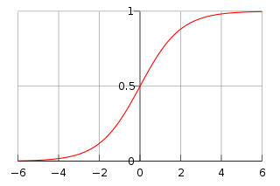
Logistic Regression Model
The “Swiss Army Knife” of classical statistical predictive modeling
Modeling Propensity of an Outcome
Heart attack or stroke
Hospital readmission
Consumer behavior, e.g., product purchase, churn
Nonlinear – No closed form equations for model parameters; must be solved using Maximum Likelihood Estimation (MLE)
Solve using MS Excel Solver (GRG) for Nonlinear Programming or MATLAB

Slide 30














Analytics Architecture Flow – BlueKC (Cobalt Ventures - Cobalt Talon, LLC)
Enterprise Systems
IBM DB2 UDB
Enterprise Data Warehouse
Analytics Data Warehouse
ETL
44 Source Systems
IBM SPSS
Business Problems or Questions
Cloud
Hosting
Patient Risk Profiles
Patient Outcome Predictions
Patient Outcome Likelihoods
Decision Makers
$
Analytical Models

Slide 32
Case Analysis
Orthopedic Surgery (Hip, Knee)
Re-admission Predictor

